Slide 1



The effect of a loaded collagen hydrogel on the engraftment and maturation of iPSC-DAPs
Preclinical therapeutic validation in immunosuppressed rats
Sarah Crudden
PhD Candidate in the University of Galway
Supervised by PROF. EilíS dowd

Slide 2
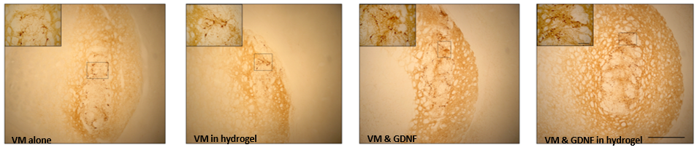
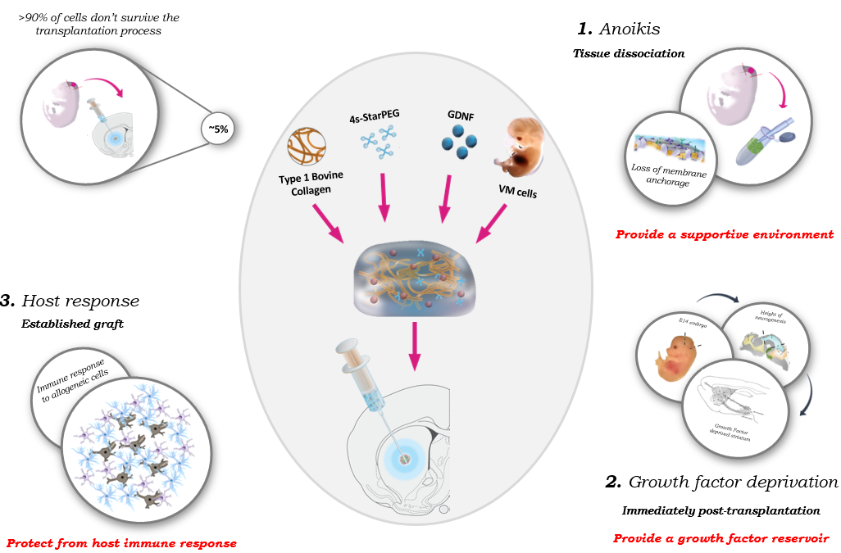
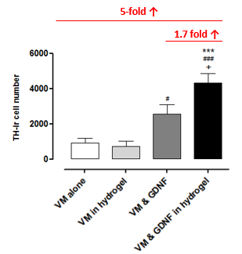
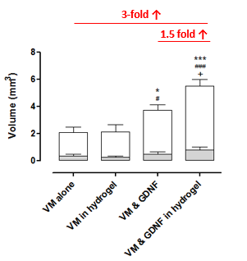
Moriarty et al., 2017
Moriarty et al., 2019
Background
  Previously demonstrated by Dowd group that an NTF-loaded collagen hydrogel can enhance survival, engraftment of VM-derived fetal cells in hemi-parkinsonian rats.
Moriarty et al., 2017
Moriarty et al., 2019

Slide 3
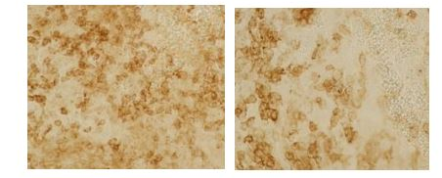
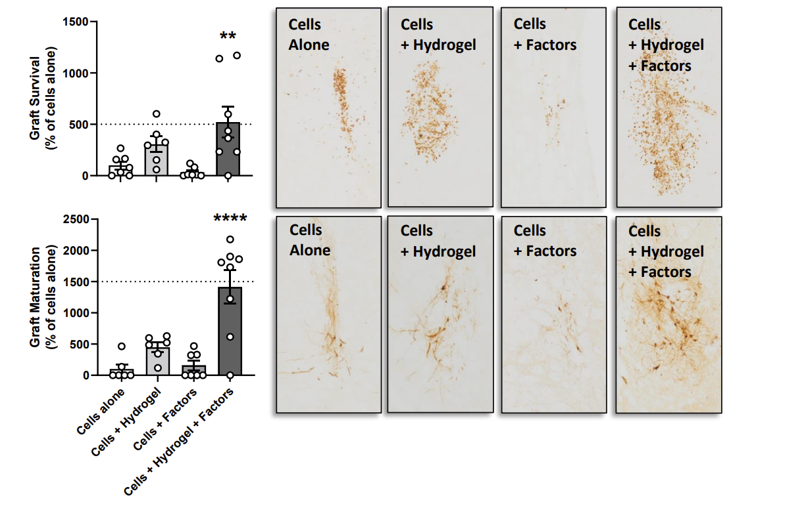
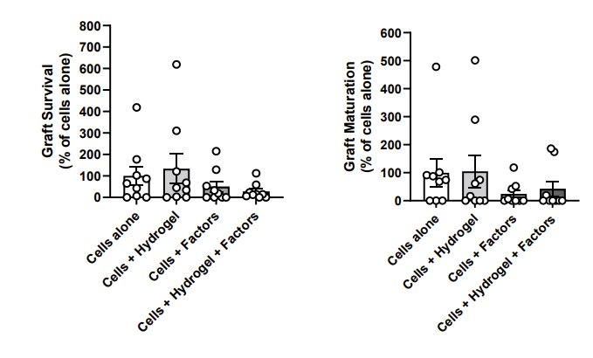
Hydrogel and iPSC-DAPs
CD4+ T-cells
CD8+ T-cells
Hydrogel improved survival and differentiation of iPSC-DAPs in athymic rats
1-day cyclosporine immunosuppression in immunocompetent rats:
  Benefits of hydrogel not seen for survival or differentiation
  T-cell infiltration
NAS2 cell line provided by Prof. Kunath's lab
Comini et al., 2024
Jarrin et al., - unpublished

Slide 4
Aim
  Aim: Improve the survival and maturation of iPSC-DAPs using a biomaterial approach (collagen hydrogel) in immunosuppressed but immunocompetent animals
    Modify the immunosuppression regime and cell line in order to achieve best possible outcomes

Slide 5
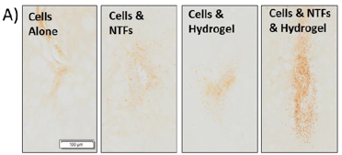
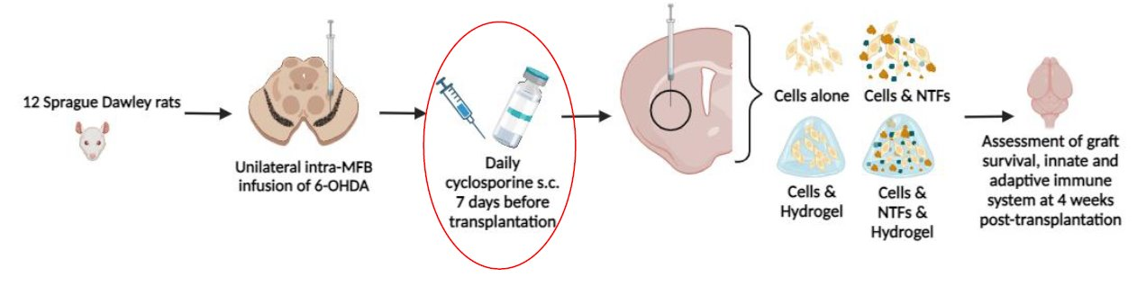
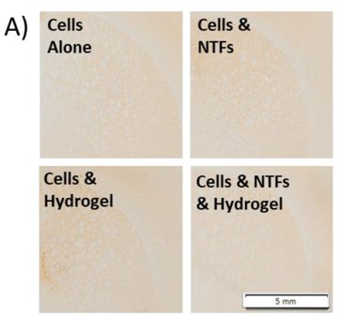
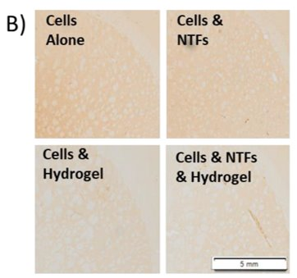
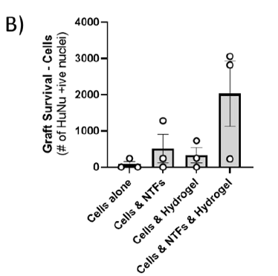
Pilot: 7-day pre-treatment of cyclosporine
Potential benefit of hydrogel on the survival of cells
Next step was a long-term study to investigate the hydrogel's impact on differentiation
No CD4+ (A) or CD8+ (B) T-cells present when a 7-day cyclosporine pre-treatment was implemented
NAS2 cell line provided by Prof. Kunath's lab
Comini., 2024

Slide 6
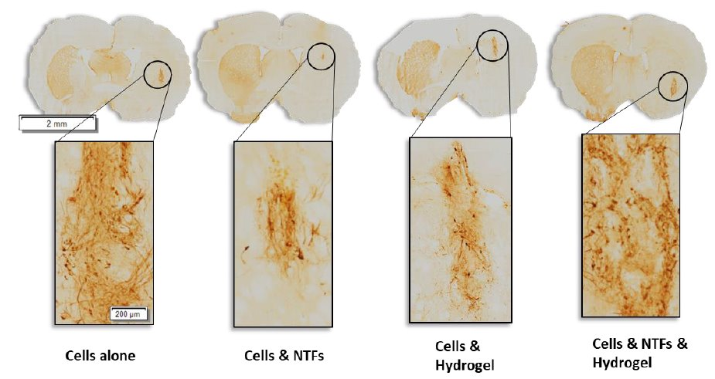
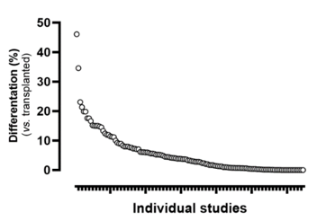
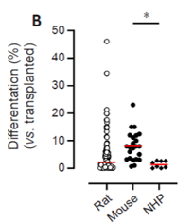
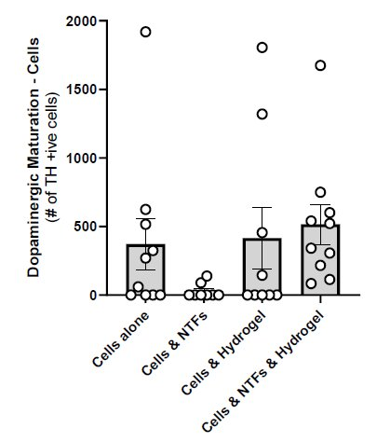
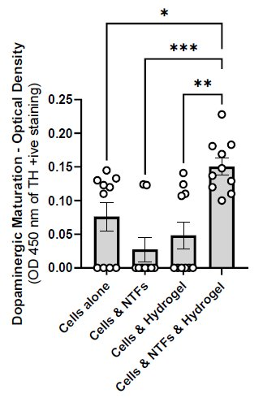
Hydrogel improves maturation of cells
Differentiation of iPSC-DAPs to mature dopaminergic neurons remains an issue
  Systematic review of literature revealed low levels of differentiation across transplantation studies
In this long-term study, the enriched collagen hydrogel improved the maturation of iPSC-DAPs to dopaminergic neurons
NAS2 cell line provided by Prof. Kunath's lab
Comini and Dowd., 2024
Comini, 2024

Slide 7
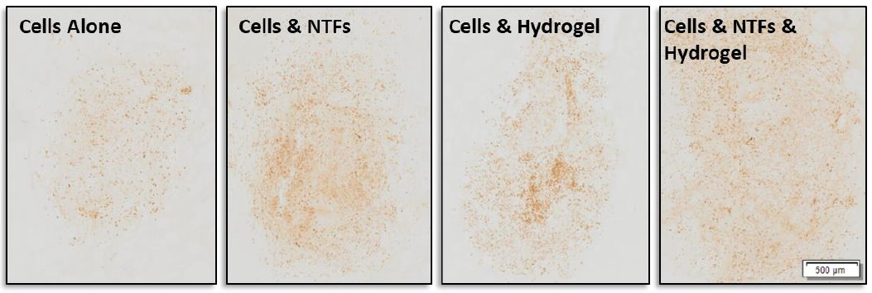
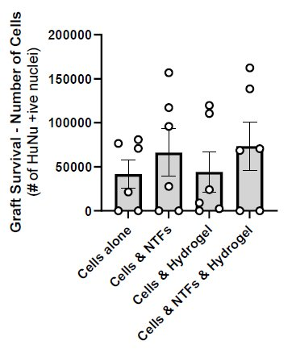
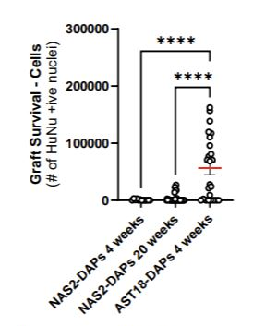
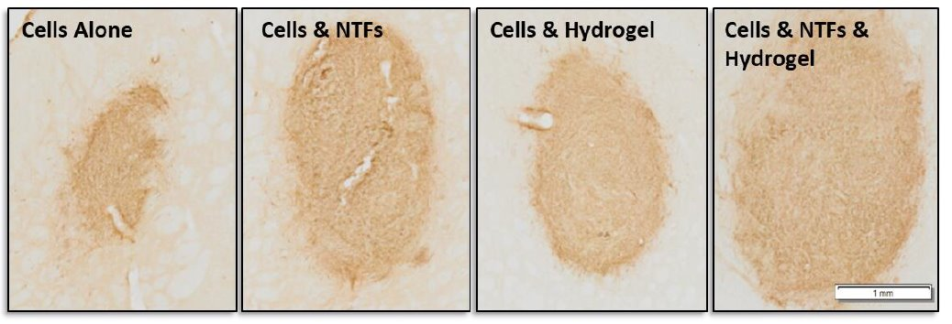
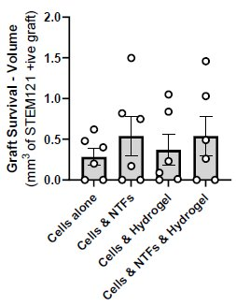
AST18 cells – Promising survival
Due to the poor overall survival of the NAS2 cell line, the hydrogel was trialed with the AST18 line
Overall survival was much better with AST18’s but there was no added benefit of the hydrogel
AST18 cell line provided by Prof. Kunath's lab
Comini., 2024

Slide 8

Conclusions and Future Directions
The enriched collagen hydrogel improves the survival and maturation of iPSC-DAPs in immunocompromised athymic rats
1 day pre-treatment of Cyclosporine was not sufficient in preventing an immune reaction to the transplanted cells
7-day pre-treatment sufficiently prevents T-cell infiltration
The hydrogel is potentially beneficial for survival and maturation of iPSC-DAPs
Beneficial for NAS2 cell line – poor overall survival
Better overall survival with AST18 cell line but no added benefit of hydrogel
Good survival of RM3.5 cell line – no benefit of hydrogel – see poster
QR code for Comini and Dowd., 2024
AST18 cell line provided by Prof. Kunath's lab and RM3.5 cell line provided by Prof. Parish’s lab

Slide 9
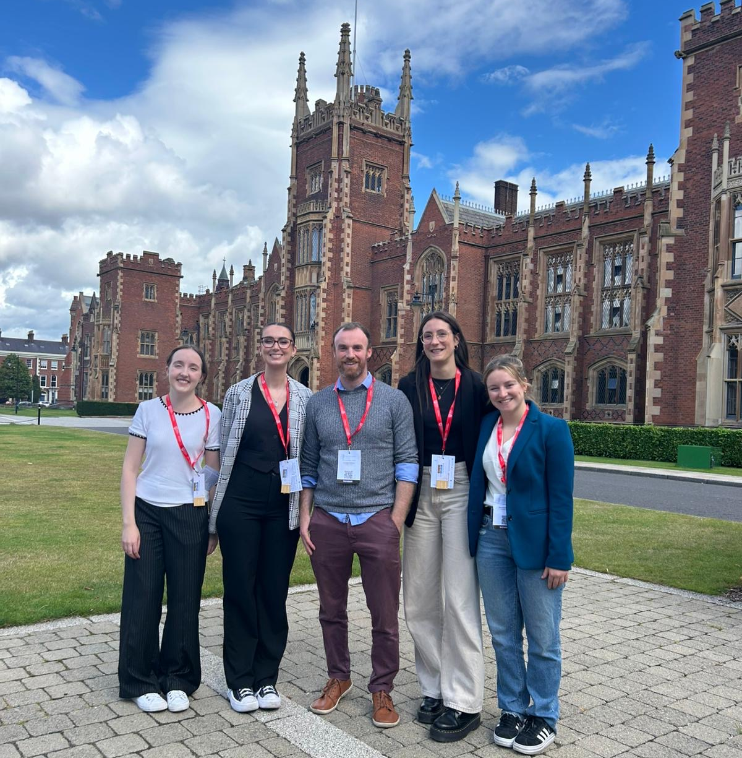




Acknowledgments
The Michael J. Fox Foundation for funding this research
The Dowd group:
    Prof Eilís Dowd
    Dr Giulia Comini
    Mr Tommy Patton
    Ms Saoirse Ryan
    Ms Sienna Stucke
    Ms Robyn Gaffey
The University of Edinburgh:
    Prof Tilo Kunath
    Dr Nicola Drummond
    Ms Michela Barbato
The Florey Institute Melbourne:
    Prof Clare Parish
    Dr Niamh Moriarty
Technical staff in the University of Galway:
    Dr Claire Feerick
    Ms Erin Molloy
    Dr Danny Kerr

Slide 10
References
Comini, G., & Dowd, E. (2024). A systematic review of progenitor survival and maturation in Parkinsonian models. Neural regeneration research, 10.4103/NRR.NRR-D-24-00894. Advance online publication. https://doi.org/10.4103/NRR.NRR-D-24-00894
Comini, G., Kelly, R., Jarrin, S., Patton, T., Narasimhan, K., Pandit, A., Drummond, N., Kunath, T., & Dowd, E. (2024). Survival and maturation of human induced pluripotent stem cell-derived dopaminergic progenitors in the parkinsonian rat brain is enhanced by transplantation in a neurotrophin-enriched hydrogel. Journal of neural engineering, 21(2), 10.1088/1741-2552/ad33b2. https://doi.org/10.1088/1741-2552/ad33b2
Comini, G. (2024) The potential of neurotrophin-loaded biomaterials to enhance stem cell-derived brain repair for Parkinson&apos;s disease. Galway: University of Galway.
Moriarty, N., Pandit, A. and Dowd, E. (2017) ‘Encapsulation of primary dopaminergic neurons in a GDNF-loaded collagen hydrogel increases their survival, re-innervation and function after intra-striatal transplantation’, Scientific reports, 7(1), pp. 16033–14.
Moriarty, N., Parish, C.L. and Dowd, E. (2019) 'Primary tissue for cellular brain repair in Parkinson's disease: Promise, problems and the potential of biomaterials', Eur J Neurosci, 49(4), 472-486, available: http://dx.doi.org/10.1111/ejn.14051.
Sarah Jarrin and Sílvia Cabré and Eilís, D. (2021) 'The potential of biomaterials for central nervous system cellular repair', Neurochemistry International, 144, 104971, available: http://dx.doi.org/https://doi.org/10.1016/j.neuint.2021.104971.

